Slide 1
Data Structure
1-‹#›
Notes:
‹#›

Slide 2
Contents
Collection
Fixed size array
Linked Node
List / Linked List
Stack
Queue
Java classes
Improving Ideas
1-‹#›

Slide 3
The ADT Collection
Definition
A finite collection of objects
Possible behaviors
Get number of items
Check for empty
Add, remove items
?
Design decision
What is an item?
Can contain duplicate items?

Slide 4
Item - Address
public class Address {
String country;
String province;
String city;
String address;
}
1-‹#›

Slide 5
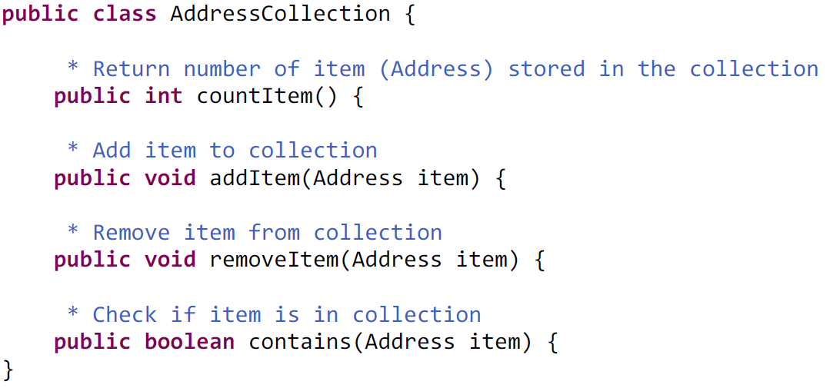
Example: AddressCollection

Slide 6
How to use
public void testAddressCollection() {
AddressCollection addresses = new AddressCollection();
Address address = new Address();
addresses.addItem(address);
addresses.contains(address);
}
1-‹#›

Slide 7
Implement AddressCollection
🡺 AddressCollection-Implementation.java.pdf
public class AddressCollection {
* Data Structure to store addresses
Address[] addresses;
* Index of last Item (excluded)
int lastIndex = 0;
* Add item to collection
public void addItem(Address item) {
if (lastIndex == addresses.length) {
removeAt(0);
}
addresses[lastIndex++] = item;
}
1-‹#›

Slide 8
Other Collections
One collection for each of object?
Student
Faculty
Staff
Class
Course
Assignment
1-‹#›

Slide 9
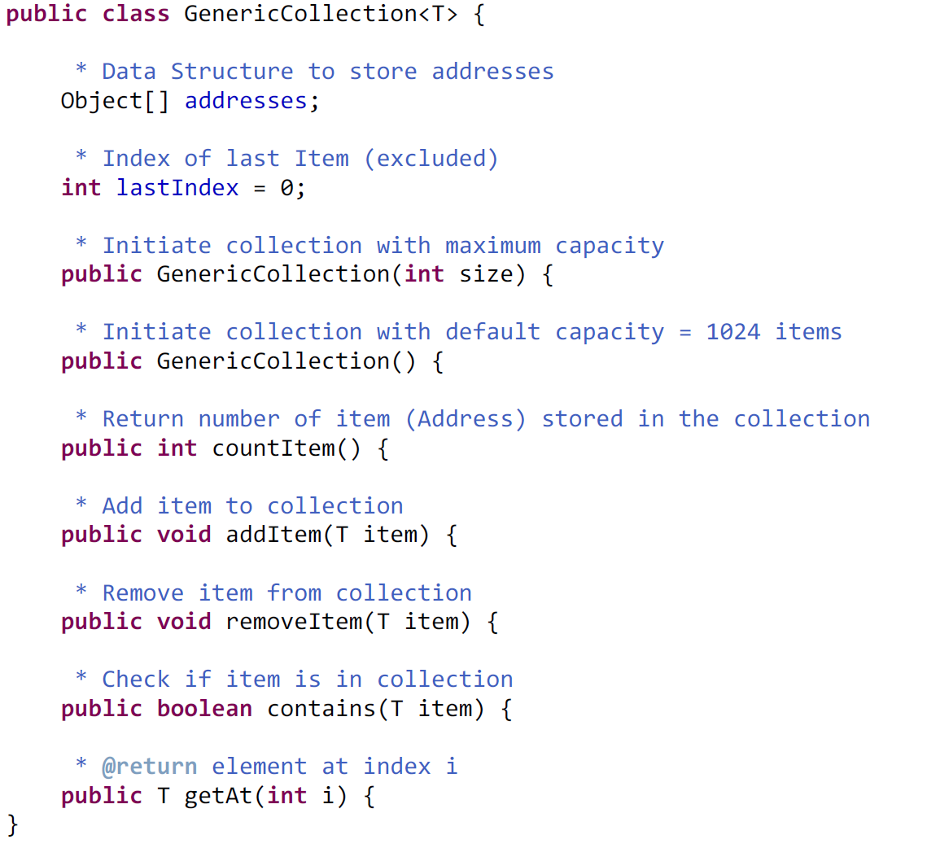
Generic
🡺 GenericCollection.java.pdf
1-‹#›

Slide 10
Generic – How to use
GenericCollection<Address> addresses1 = new GenericCollection<Address>();
GenericCollection<Address> addresses2 = new GenericCollection<Address>();
~Address[] arrayAddress = new Address[100]
addresses.addItem(new Address());
addresses.addItem(new Address());
addresses.addItem(new Address());
Address address = addresses.getAt(0);
1-‹#›

Slide 11
Generic – How to use
GenericCollection<Student> students = new GenericCollection<Student>();
students.addItem(new Student("Tuan", new Date(), "tuan@eiu.edu.vn"));
students.addItem(new Student("Tien", new Date(), "tien@eiu.edu.vn"));
students.addItem(new Student("Quang", new Date(), "quang@eiu.edu.vn"));
Student student = students.getAt(0);
1-‹#›

Slide 12
Problems with Array Implementation
Array has fixed size
May become full
Alternatively may have wasted space
Resizing is possible but requires overhead of time

Slide 13
A chain of components
A
B
Head
1-‹#›

Slide 14
A chain of components
Head
A
B
C
1-‹#›

Slide 15
A chain of components
Head
A
B
C
D
1-‹#›

Slide 16
A chain of components
Head
A
B
C
D
1-‹#›

Slide 17
A chain of components
A
Head
C
B
D
1-‹#›

Slide 18
SimpleLinkedNode
public class SimpleLinkedNode {
int sampleData1;
String sampleData2;
Address sampleData3;
SimpleLinkedNode next;
}
A
1-‹#›

Slide 19
Generic: LinkedNode<T>
public class LinkedNode<T> {
T data;
LinkedNode<T> next;
}
1-‹#›

Slide 20
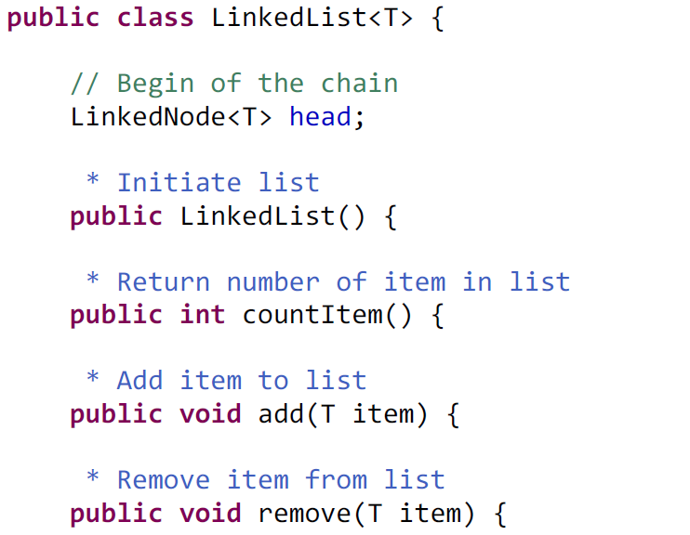
LinkedList<T>
LinkedList-abstract.java.pdf
1-‹#›

Slide 21
Double Linked List
Head
A
B
C
1-‹#›

Slide 22
Double Linked List
Head
A
B
C
1-‹#›

Slide 23
Common Data Structures
Array
Stack: FILO
Queue: FIFO
Dictionary: Lookup value by Key
List
ArrayList
LinkedList
Thanks god: java.util.*
1-‹#›

Slide 24
java.util.*
List<Address> addresses = new ArrayList<Address>();
addresses.add(new Address());
Address add1 = addresses.get(0);
addresses.add(new Address());
addresses.set(1, new Address());
Address add2 = Addresses.get(i);
int size = addresses.size();
Compare to Array?
Address[] addressArray = new Address[100];
addressArray[0] = new Address();
addressArray[1] = new Address();
size = addressArray.length;
1-‹#›

Slide 25
java.util.*
1-‹#›

Slide 26
java.util.*
LinkedList<Address> linkedList = new LinkedList<Address>();
linkedList.add(new Address());
linkedList.size();
linkedList.removeFirst();
linkedList.removeLast();
1-‹#›

Slide 27
java.util.*
ArrayList<Address> addresses = new ArrayList<Address>();
addresses.add(new Address());
Address add1 = addresses.get(0);
addresses.sort(new Comparator<Address>(){
@Override
public int compare(Address arg0, Address arg1) {
return 0;
}
});
Collections.sort(addresses);
1-‹#›

Slide 28
java.util.*
Stack<Address> stack = new Stack<Address>();
stack.push(new Address());
Address add2 = stack.peek();
Address add3 = stack.pop();
Queue<Address> queue = new LinkedList<Address>();
queue.add(new Address());
queue.peek();
queue.poll();
queue.remove();
1-‹#›

Slide 29
java.util.*
String name = "Ngoc";
Dictionary<Integer, Student> dic
= new Hashtable<Integer, Student>();
// Map<String, Integer> dic = new HashMap<String, Integer>();
Student student = dictionary.get(studentCode);
if (student == null) {
student = new Student();
}
dic.getFullName();
dic.put(studentCode, student);
Alternative view of dictionary
if(dictionary[name] == null){
dictionary[name] = value;
1-‹#›

Slide 30
java.util.*
Compare to Array, ArrayList
dictionary.put(name, value);
addresses.add(new Address());
addresses.set(1, new Address());
addressArray[0] = new Address();
addressArray[1] = new Address();
1-‹#›

Slide 31
java.util.*
PriorityQueue<Integer> minQueue = new PriorityQueue<>();
minQueue.add(3);
minQueue.add(2);
minQueue.add(1);
minQueue.add(4);
minQueue.peek(); // ==> 1
minQueue.poll(); // ==> 1
1-‹#›

Slide 32
Dynamic Array
ArrayList<T>
1-‹#›

Slide 33
Index Linked Node
1
2
3
4
5
6
7
8
9
10
1-‹#›

Slide 34
Index Linked Node
1
2
3
4
5
6
7
8
9
10
1 | 2 | 3 | 4 | 5 | 6 | 7 | 8 | 9 | 10
0 | 1 | 1 | 1 | 1 | 2 | 2 | 6 | 8 | 8
1-‹#›

Slide 35
Assignments
Implement: GenericCollection<T>, LinkedList<T>
add(item), remove(item), contains(item)
count(), indexOf(item), getAt(i)
insertBefore(after, item)
insertAfter(before, item)
Implement Stack<T>, Queue<T>
1-‹#›

Slide 36
Quizzes
Chapter 1, 2, 3, 5, 6
1-‹#›

